Slide 1


Smart Farm - Crop Growth & Resource Management Simulator

Slide 2

Members & assignment
Member | Contribution level | Individual tasks
Nguyễn Quốc Cường | 24% | Core engine, input, rendering core, integration
Trịnh Hoàng Đại Hải | 19% | Controller layer
Bùi Minh Hải | 19% | View / rendering layer
Lê Anh Đức | 19% | Crop model, catalog and pest
Vũ Nguyễn Trung Kiên | 19% | Weather and trigger package and farm grid model

Slide 3
Problem statement
The Smart Farm project was chosen because it provides a practical and visual environment for applying core Object-Oriented Programming principles:
Uses inheritance to model different crop types.
Uses polymorphism to implement various weather behaviors.
Ensures encapsulation of farm cells and crop states.
Follows the MVC architecture to separate Model, View, and Controller responsibilities.
Includes a custom rendering engine built directly on Java AWT Canvas.
Does not rely on any external game engine, providing deeper understanding of software design and implementation.

Slide 4
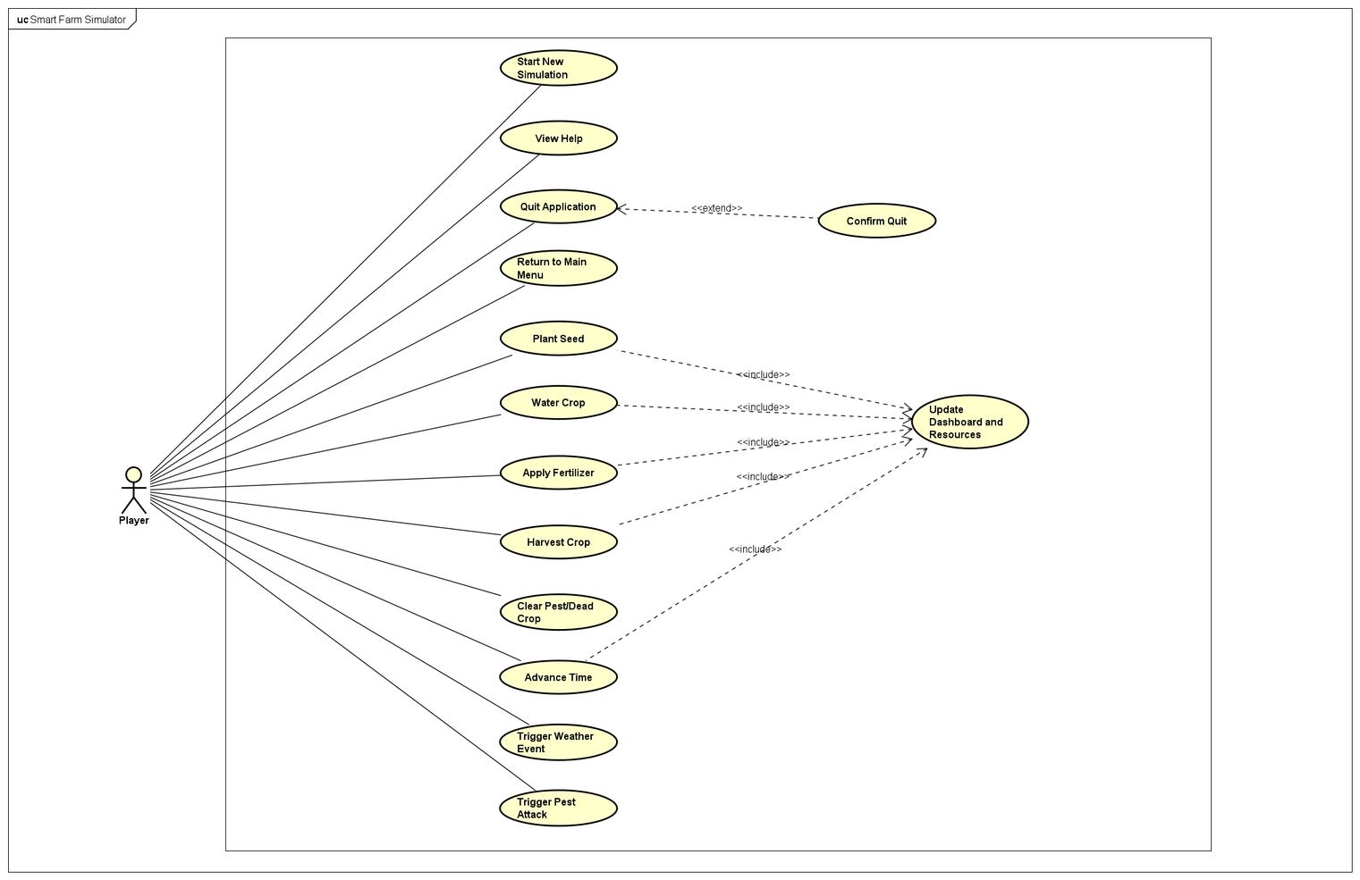
Usecase diagram

Slide 5
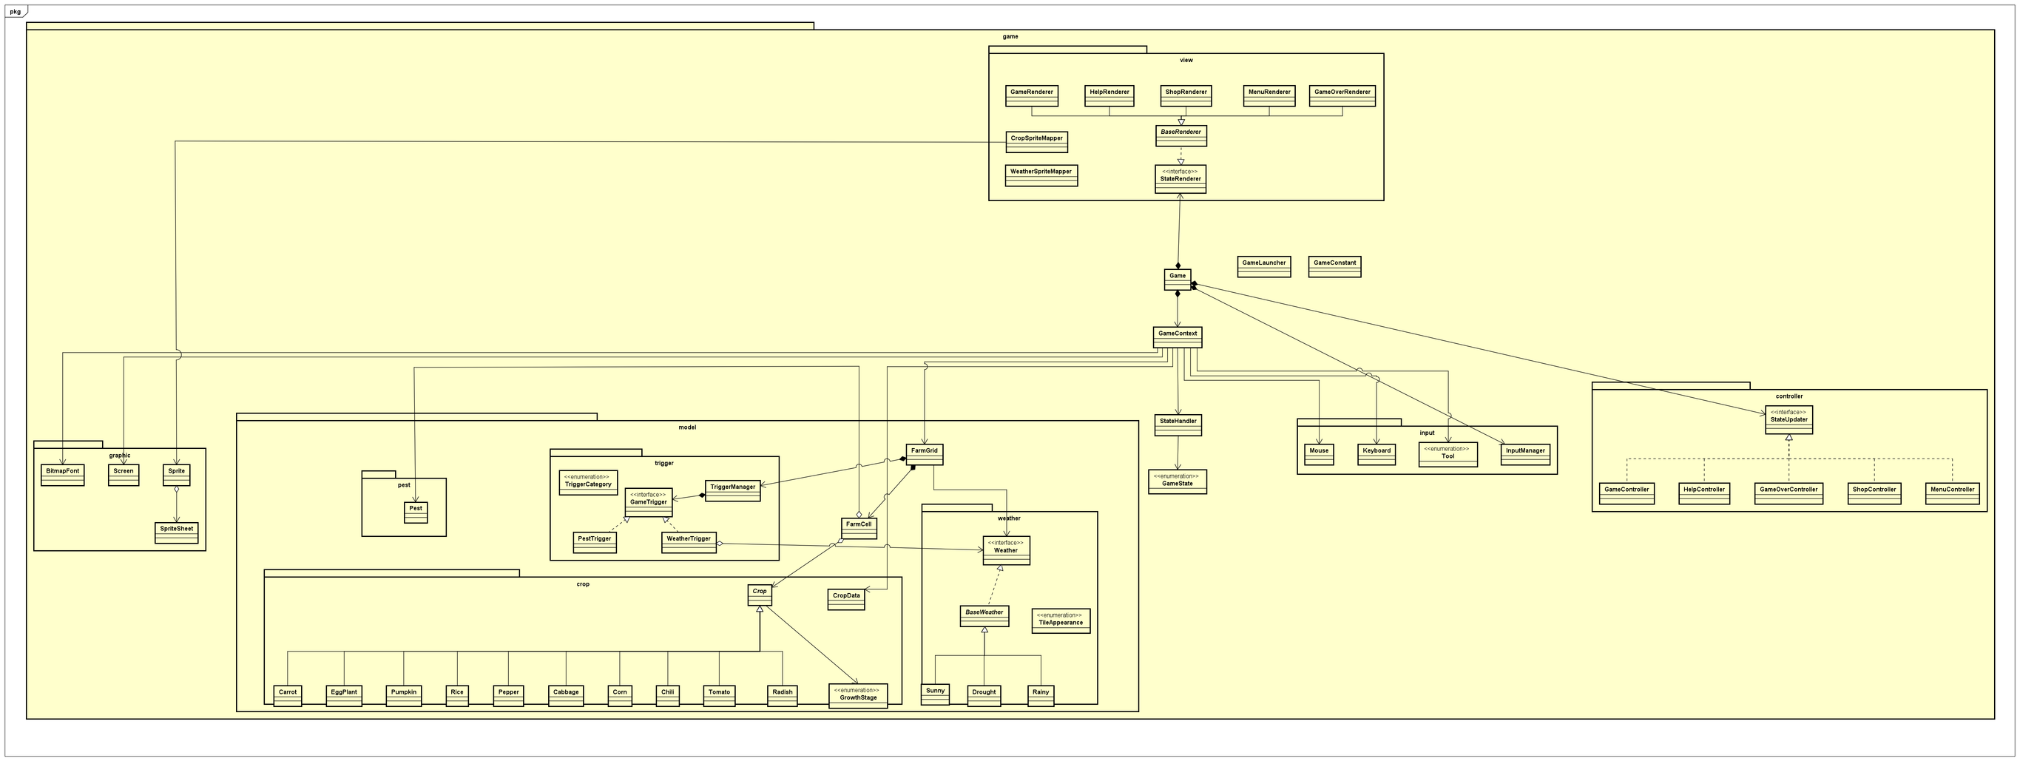
General class diagram

Slide 6
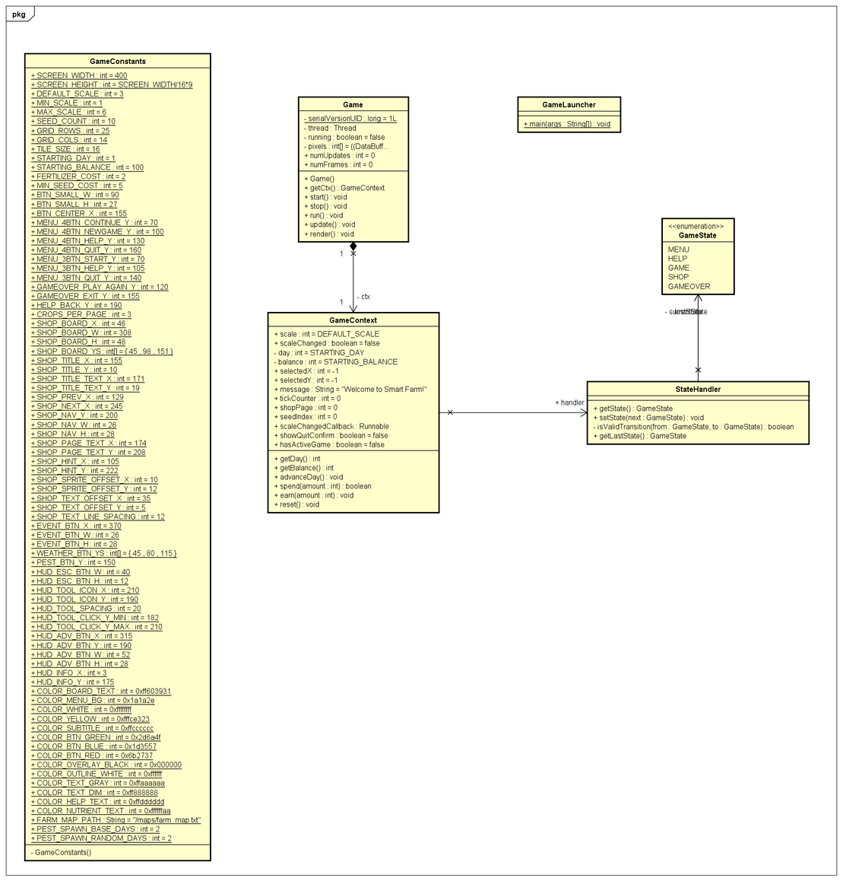
Class diagrams for Core Game Architecture

Slide 7
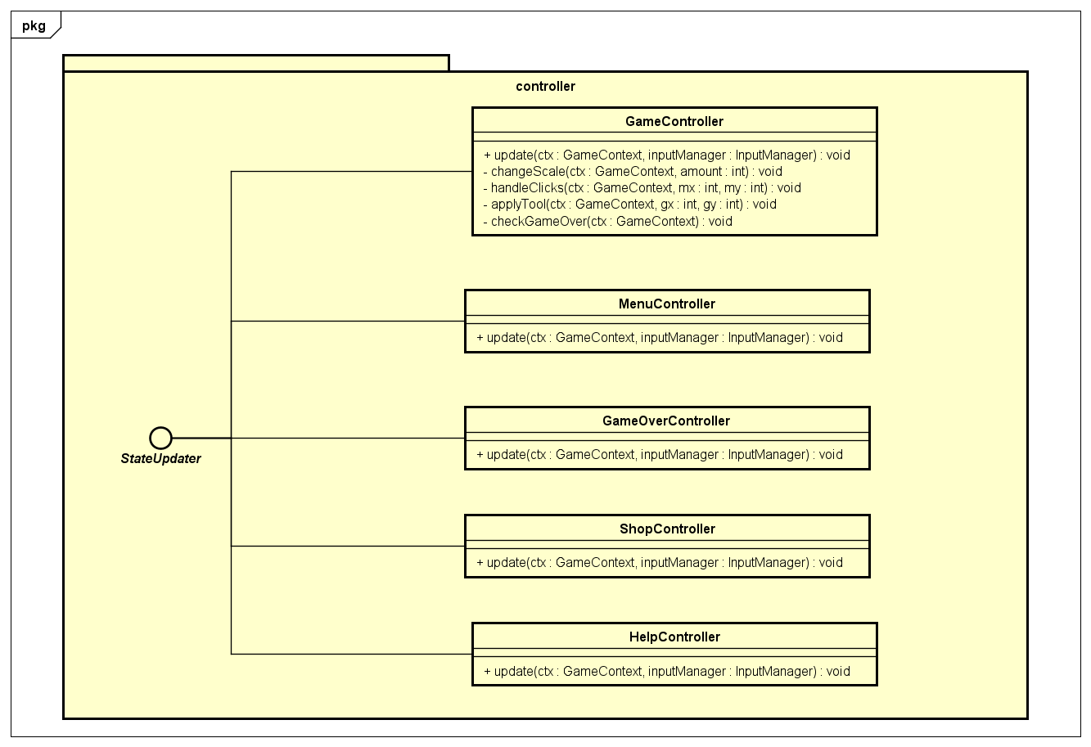
Class diagrams for controller package

Slide 8
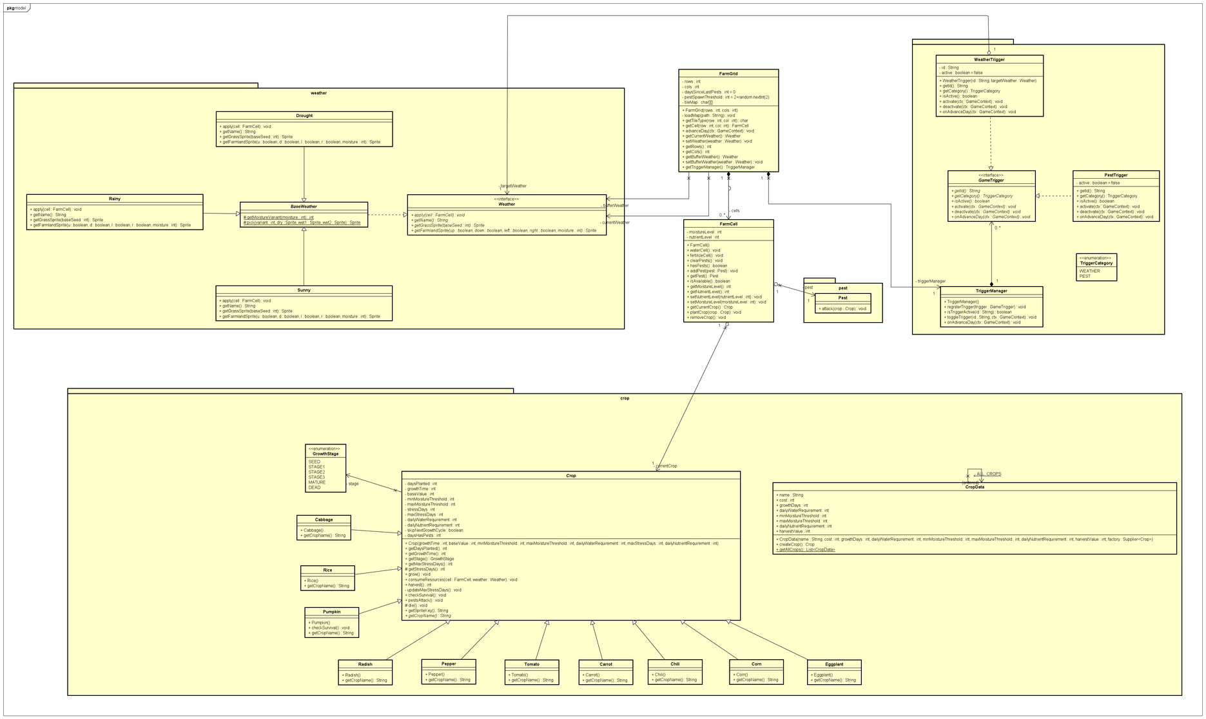
Class diagrams for model package

Slide 9
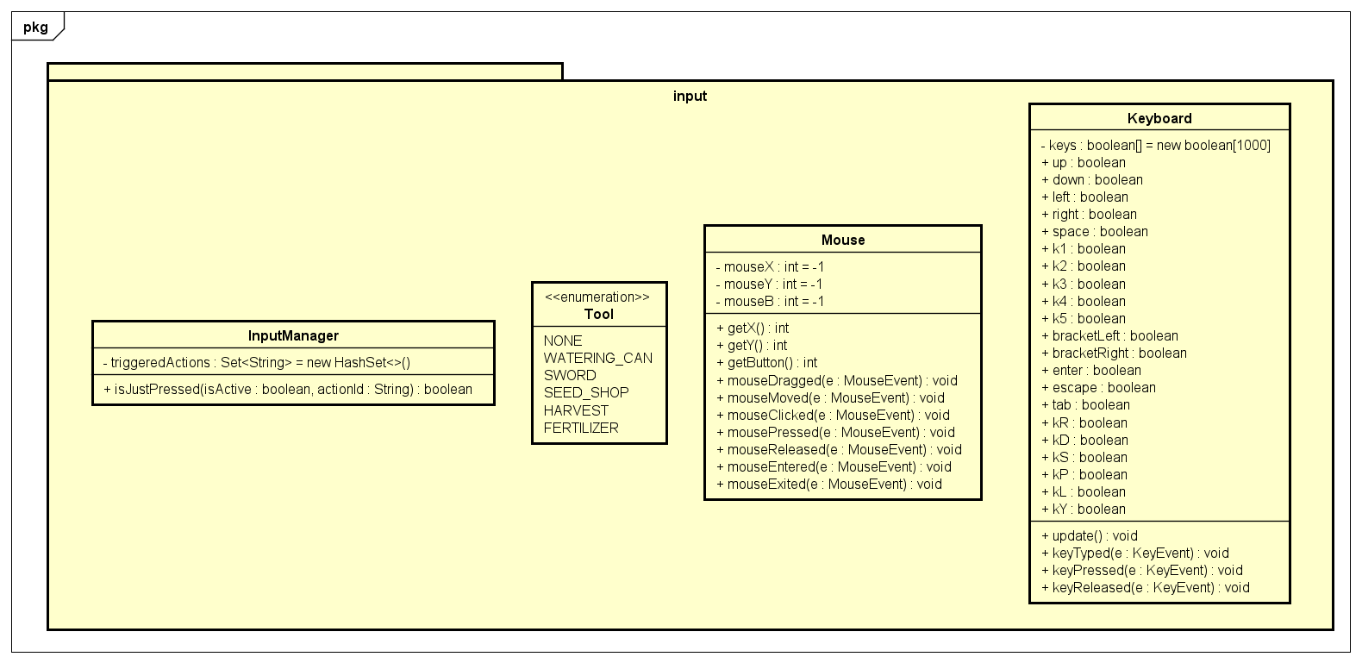
Class diagrams for input package

Slide 10
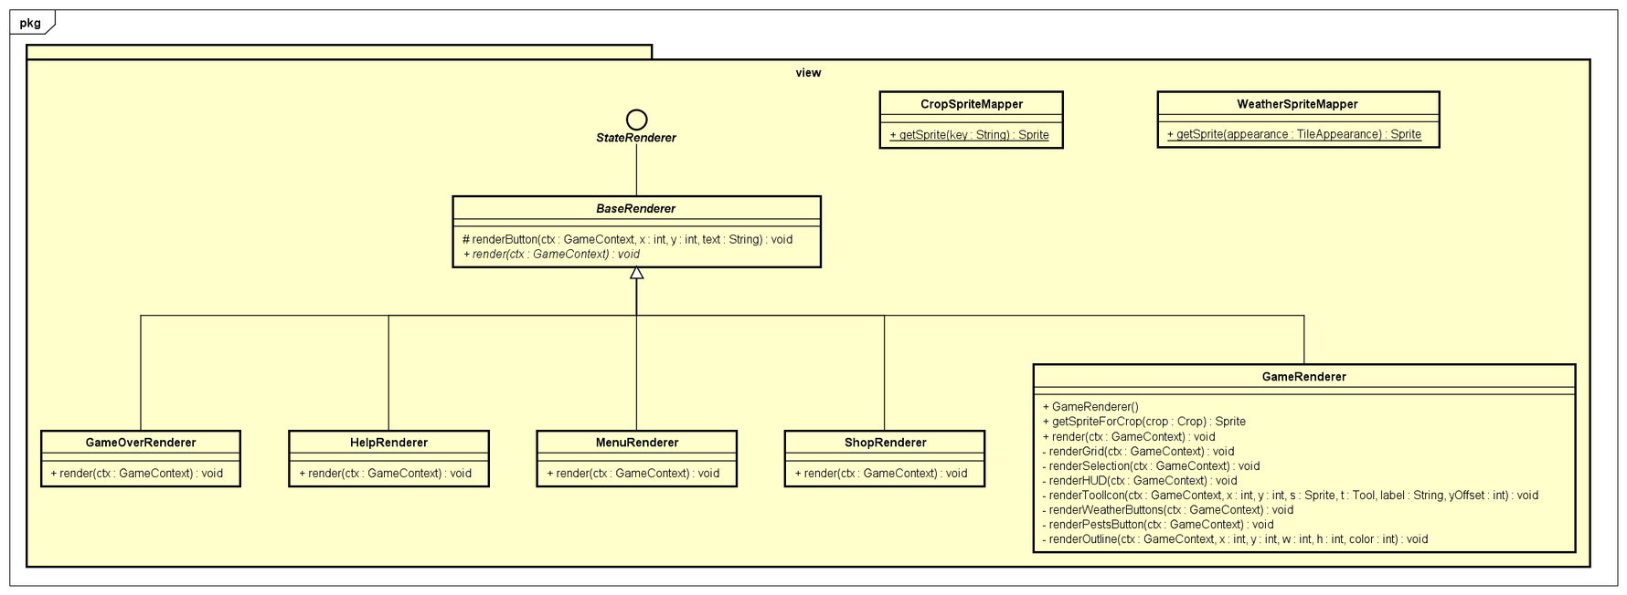
Class diagrams for view package

Slide 11
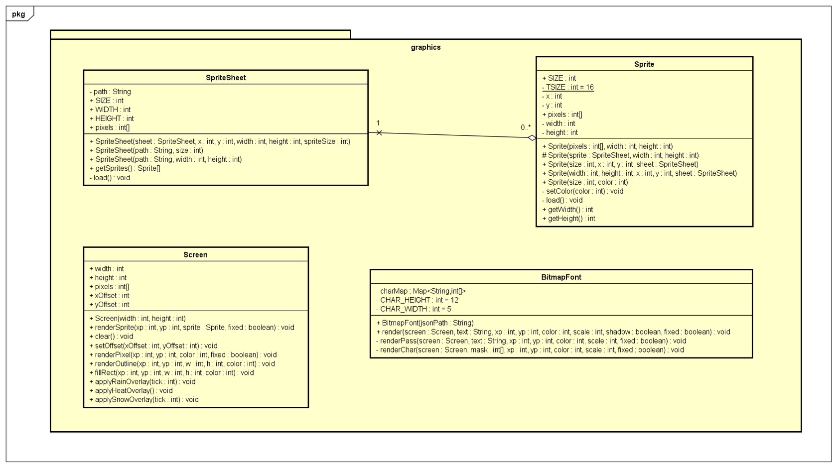
Class diagrams for graphics package

Slide 12
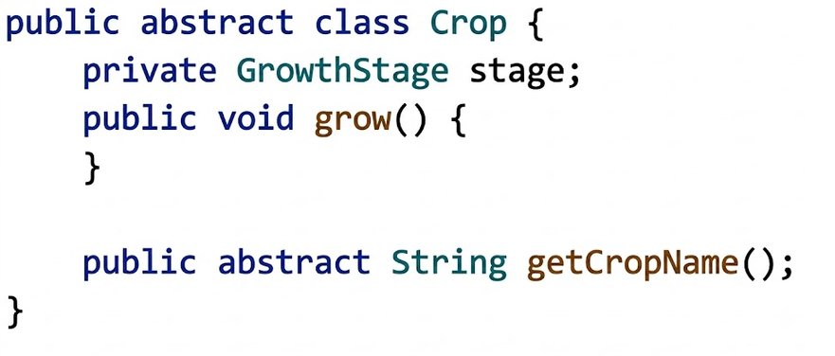
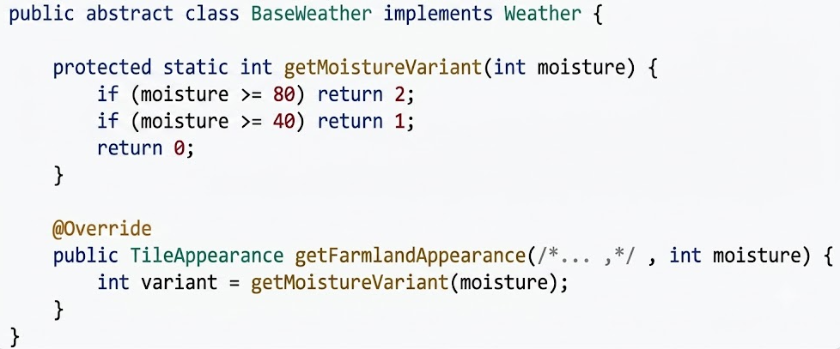
OOP Principles: Abstraction
High-Level Design: The abstract Crop class defines the common lifecycle (growth, consumption, survival) while hiding specific crop implementations.
Shared Behaviors: BaseWeather implements the Weather interface, providing shared logic while deferring specific effects to subclasses.

Slide 13
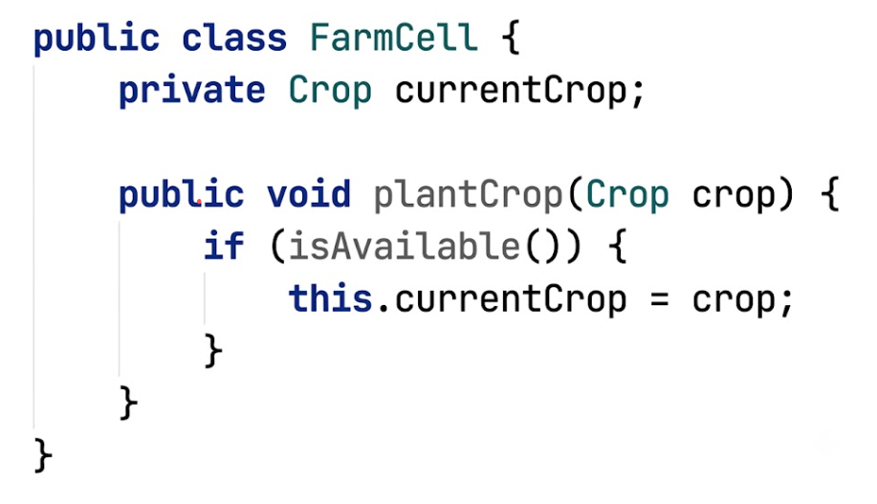
OOP Principles: Abstraction
Client classes (FarmCell, FarmGrid, GameController) interact strictly via abstract types (Crop, Weather) rather than concrete classes.
For example, the code above demonstrates that FarmCell only knows that it contains a Crop object. It does not need to know whether the actual object is a Rice, Tomato, or Pumpkin. The cell interacts with the crop through the abstract Crop type and its public operations.

Slide 14
OOP Principles: Encapsulation
FarmCell encapsulates the state of a farm tile (moistureLevel, nutrientLevel, hasPests, and currentCrop) by declaring them as private. Other classes must interact with a cell through methods such as waterCell(), fertilizeCell(), plantCrop(), and clearPests() instead of modifying its fields directly.
Crop encapsulates its lifecycle state (daysPlanted, stressDays, stage, skipNextGrowthCycle, etc.). External classes cannot directly manipulate these values; all updates occur through crop operations such as grow(), consumeResources(), and checkSurvival().
GameContext makes attributes day and balance private , exposing only controlled operations. This prevents any controller from directly writing ctx. balance = 9999 or ctx.day = -1.

Slide 15
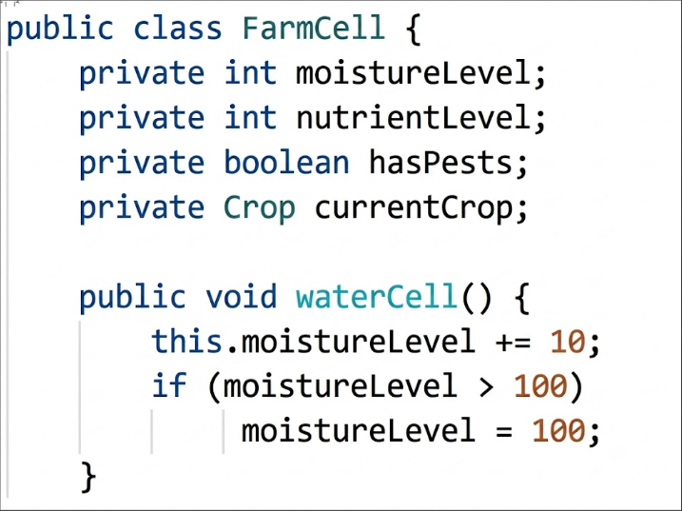
OOP Principles: Encapsulation
From the code snippet beside, we can see that FarmCell stores moistureLevel as a private field. External classes cannot change it directly and must call waterCell(), which applies the update while enforcing the maximum moisture limit. This protects the object's internal state and keeps the game data consistent.
→ By keeping validation and state-transition logic inside the owning classes, the project prevents invalid game states and maintains object consistency.

Slide 16
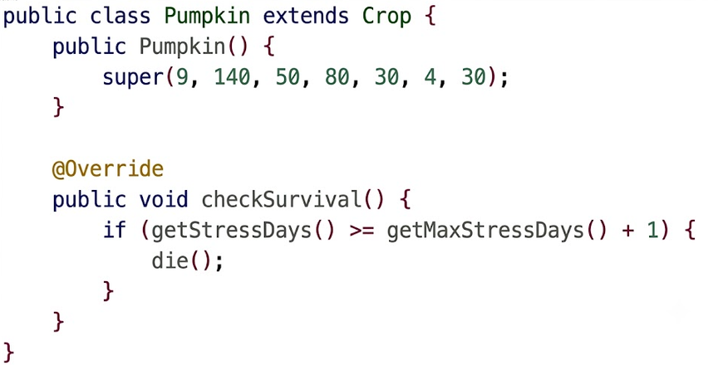
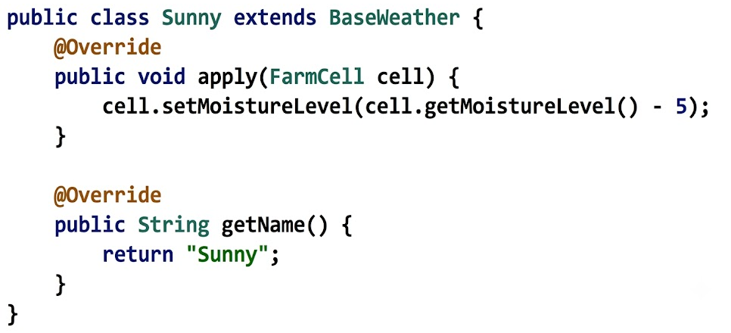
OOP Principles: Inheritance
Crop Hierarchy: Rice, Radish, and Pumpkin extend the Crop class, fully reusing the standard lifecycle logic.
Weather Hierarchy: Sunny and Rainy extend BaseWeather, inheriting base utilities while overriding specific weather effects.

Slide 17
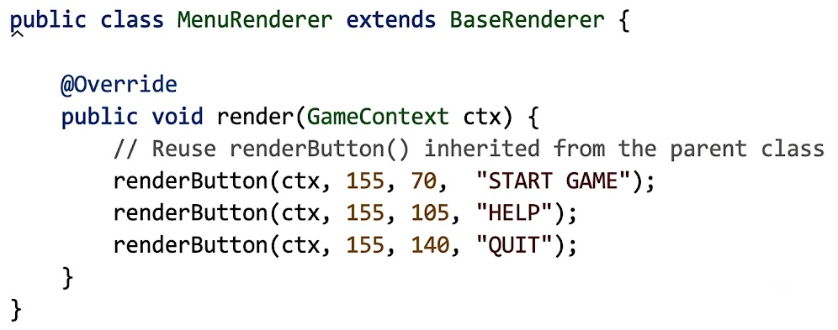
OOP Principles: Inheritance
Renderer Hierarchy: All UI renderers inherit from BaseRenderer to reuse drawing utilities like renderButton().
→ Through inheritance, subclasses seamlessly reuse foundational parent logic while overriding specific rules to implement their own specialized game mechanics.

Slide 18
OOP Principles: Polymorphism
Weather polymorphism: Sunny, Rainy, and Drought implement the Weather interface. The game interacts only with the Weather type, while the correct weather-specific behavior is selected at runtime.
Crop polymorphism: The game interacts only with the abstract Crop type. The actual crop species (Rice, Pumpkin, Radish, etc.) is determined at runtime, and overridden methods are dynamically dispatched to the appropriate implementation, enabling crop-specific behavior.
System polymorphism: StateUpdater, StateRenderer, and allow the game loop to invoke update(), render()without knowing the concrete controller, renderer, or trigger type.
Trigger polymorphism: Different trigger types (WeatherTrigger, PestTrigger) are managed through the GameTrigger interface. TriggerManager invokes the same operation on all triggers, while each trigger executes its own specialized behavior.

Slide 19
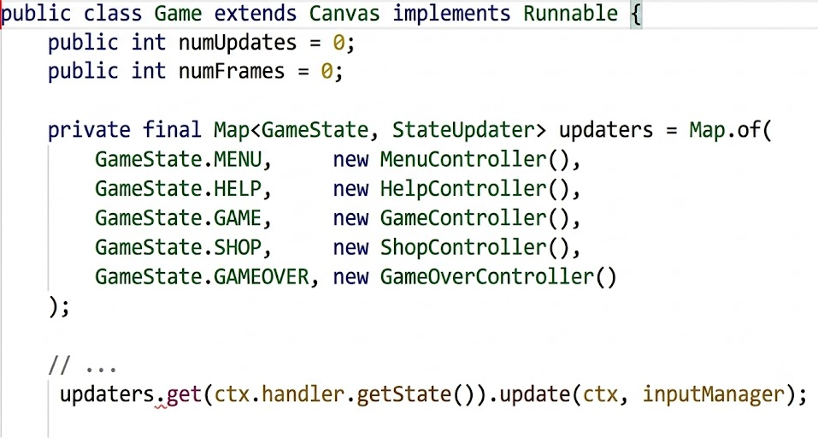
OOP Principles: Polymorphism
For example: The game loop interacts only with the StateUpdater interface and does not need to know whether the current object is a MenuController, HelpController, GameController, or ShopController. Based on the current game state, Java dynamically selects the appropriate controller implementation at runtime and invokes its update() method.

Slide 20
OOP Principles: Composition
FarmGrid composes a 2D array of FarmCell objects. The cells are created inside the FarmGrid constructor and exist only as part of the grid.
FarmGrid also composes a TriggerManager, which is instantiated and owned entirely by the grid.
TriggerManager composes multiple GameTrigger objects (PestTrigger and WeatherTriggers), creating and managing them internally.

Slide 21
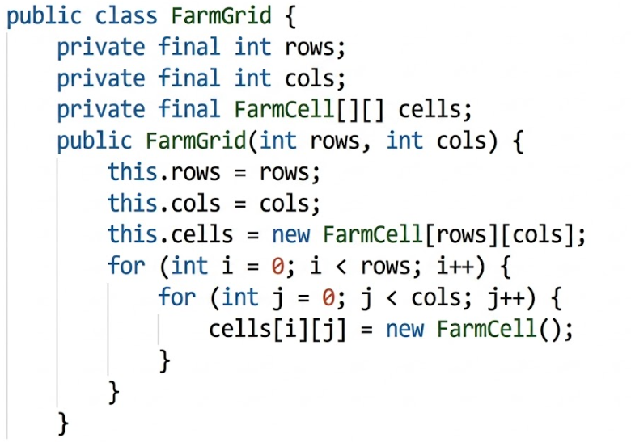
OOP Principles: Composition
For example: based on the code above, we can observe that it demonstrates Composition because the FarmGrid is responsible for the creation, ownership, and lifecycle of its cells, forming a strong whole-part relationship.

Slide 22
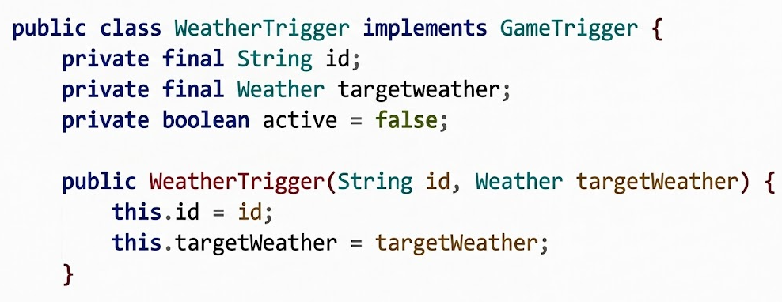
OOP Principles: Aggregation
FarmCell aggregates Cell because a FarmCell holds a reference to a Crop but does not own its lifecycle.
WeatherTrigger aggregates Weather objects.
For example: As shown in the code above, Weather instances are created outside the WeatherTrigger and passed into its constructor. The WeatherTrigger only stores a reference and does not control the weather object's lifecycle.

Slide 23
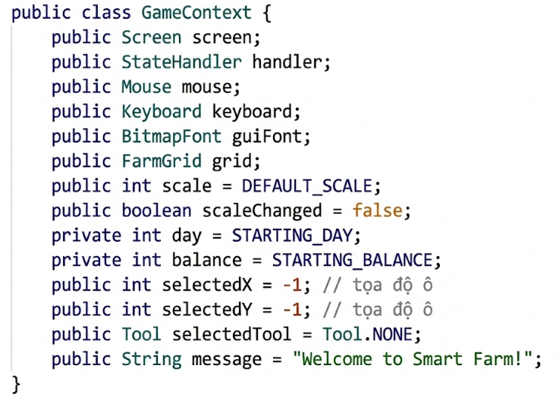
OOP Principles: Association
The GameContext class only holds references to the instances of other component classes (such as Screen, Mouse, Keyboard, and FarmGrid).
It does not create or deeply contain the internal logic of those components. This is a classic Association relationship based on object references.

Slide 24
Demo scenario
1. Interface Overview
Start: Click "Start Game" or press Enter.
Layout: Top shows Weather/Messages and Balance/Day. Bottom-left shows cell info. Bottom-right has Tools, Triggers, and "Advance Day" button.
2. Basic Farming Loop
Plant: Press P (Shop). Click to the cell or arrow keys and TAB to plant.
Care: Use Watering Can (3), Fertilizer (5), or Sword (4) to maintain cells.
Grow: Click "Advance Day" or press Enter to progress.
Harvest: Use Harvest tool (2) on mature crops for profit, or to remove dead ones.
3. Challenges & Failure
Needs: Poor care or bad weather increases a crop's "stress days".
Pests: Significantly lower crop tolerance.
Death: Crops die permanently if their stress days exceed their tolerance limit.
4. Game End
Goal: Manage resources wisely to expand and profit.
Game Over: You only lose if you cannot afford the cheapest seed and have no living crops left.

Slide 25
Video link demo our game
Link Youtube : https://www.youtube.com/watch?v=3BFZpLS1028
Link Driver : https://drive.google.com/file/d/1mfYjcHDg2fJgbQf9V5Ci76nD3oGNog35/view?usp=sharing

Slide 26

THANK YOU !

